Slide 1

ADLV 2020
Zoom Instructions

Slide 2
Zoom Etiquette
All participants connect with video
Mute your audio
“Raise hand” if you have question (only then un-mute)
Keep the chat clean
Tracking attendance via Zoom “name”

Slide 3
Zoom Etiquette
All participants connect with video
Mute your audio – un-mute to ask questions (encouraged)
To un-mute: press and hold space bar
Keep the chat clean
Tracking attendance via Zoom “name” and a google-form (in chat)

Slide 4
Zoom instructions for lecturers
Open your slides and make all materials available before opening zoom.

Slide 5
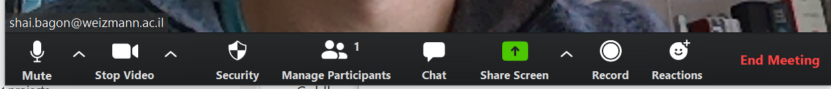
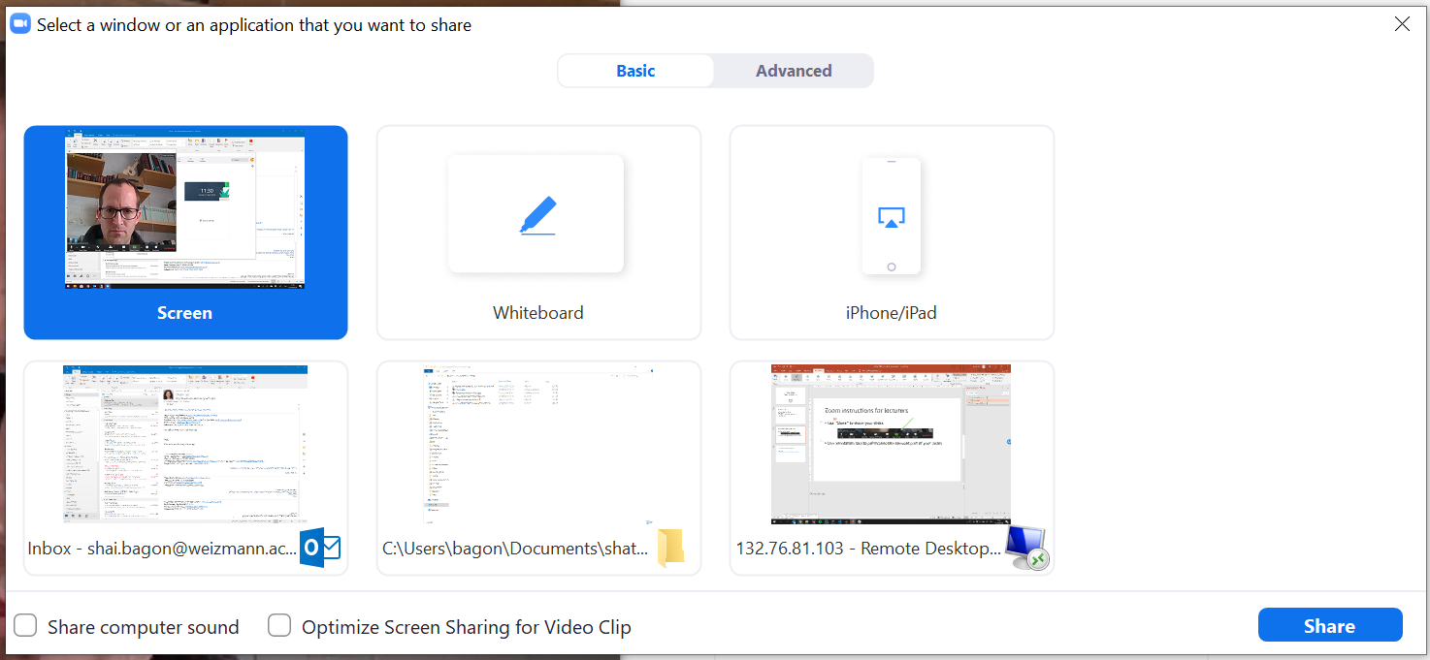
Zoom instructions for lecturers
Use “Share” to share your slides

Slide 6
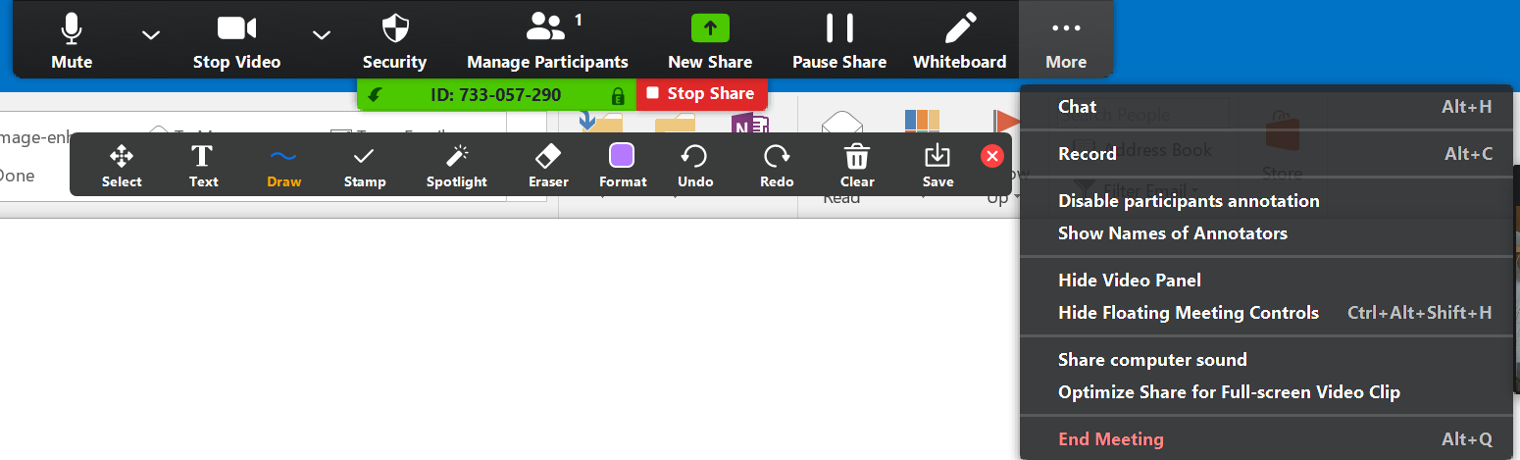
Zoom instructions for lecturers
Use annotation tool to point/annotate relevant part of your slides

Slide 7
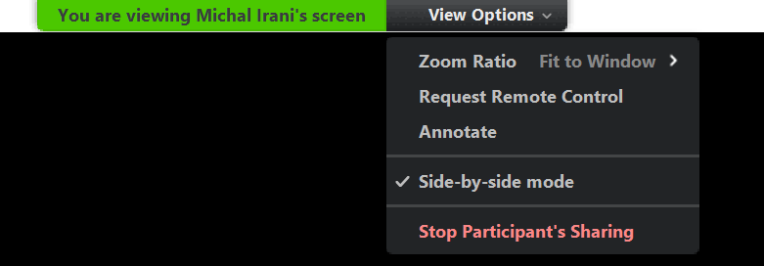
Zoom instructions for lecturers

Slide 8
Zoom instructions for lecturers
More details
https://weizmann.app.box.com/s/zj3tk36k5v4fp3xf6ui9ogppfeews2u0

